Slide 1

Cyber Security Major Project
By P Indivar

Slide 2

PROJECT DETAIls
Perform a VA on testphp.vulnweb.com
Perform a VA on your host machine/virtual machine
Prepare Customised report of both VA
Find the password of username hidden in the following directory www.varupathak.in/m1ss10n.zip
Find a way to hide a video behind the image and run it.

Slide 3


Website security testing Report
VA on testphp.vulnweb.com

Slide 4

Report Details
Website Name | Testphp.vulnweb.com
Automatic Scan Performed on | Nessus Essentials

Slide 5

Contents
Brief Summary of the assessment
Detailed Description of the Observations

Slide 6

Brief Summary of the assessment
An Overview of Website Security testing

Slide 7
Security testing - overview
Background
I performed a blackbox external vulnerability scan on the website using an automatic scanner.
The main aim of this vulnerability assessment is to identify the security issues within the website.
Result
I found several vulnerabilities which were present on the website during the assessment.
Performed Vulnerability scans to assess the website
Ranked the vulnerabilities according to threat level
Presented the results through this report

Slide 8
Risk DEFINITION
CRITICAL RISK | This risk is dangerous and utmost priority must be taken to solve these risks to avoid any loss. Anyone can attack and exploit these vulnerability very easily.
HIGH RISK | Even these risks are as dangerous as Critical risks. They need to be solved as early as possible before anyone exploits the vulnerabilities.
MEDIUM RISK | These are the vulnerabilities which can be exploited at a moderate level. But these should be solved before anyone exploits them.
LOW RISK | These are the vulnerabilities which have very less chance of being exploited. These can also be solved at later on.

Slide 9
Vulnerability Statistics
Type of Risk | No. of Vulnerabilities
Critical | 2
High | 13
Medium | 15
Low | 1

Slide 10

Detailed Description of the Observations
Explanation of each and every Vulnerability in detail

Slide 11
1) PHP Unsupported Version Detection
Observation
I found that according to its version, the installation of PHP on the remote host is no longer supported.
Risk |  | Critical |  | High |  | Medium |  | Low
Lack of support implies that no new security patches for the product will be released by the vendor. As a result, it is likely to contain security vulnerabilities
Recommendations
Upgrade to a version of PHP that is currently supported.

Slide 12
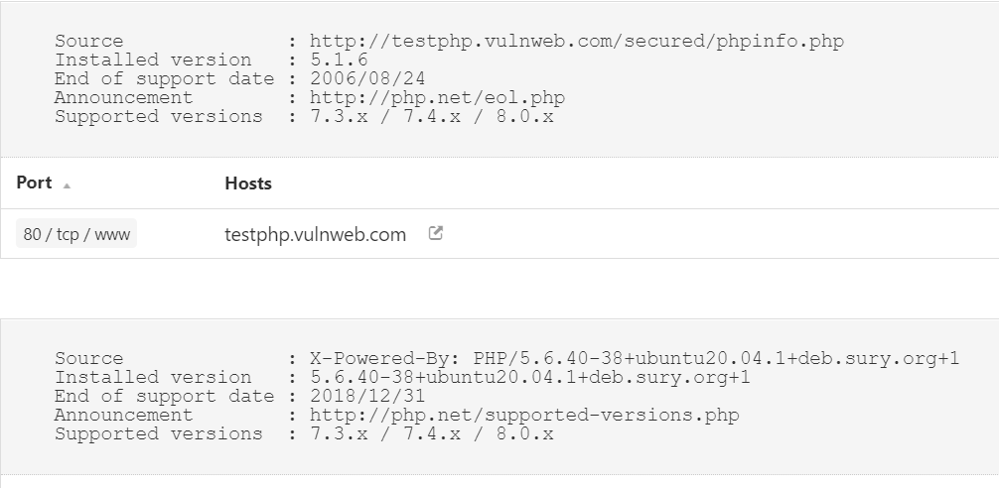
Proof of vulnerability detection

Slide 13
2) PHP < 5.2.1 Multiple Vulnerabilities
Observation
According to its banner, the version of PHP installed on the remote host is older than 5.2.1.
Risk |  | Critical |  | High |  | Medium |  | Low
Such versions may be affected by several issues, including buffer overflows, format string vulnerabilities, arbitrary code execution, 'safe_mode' and 'open_basedir' bypasses, and clobbering of super-globals.
Recommendations
Upgrade to PHP version 5.2.1 or later.

Slide 14
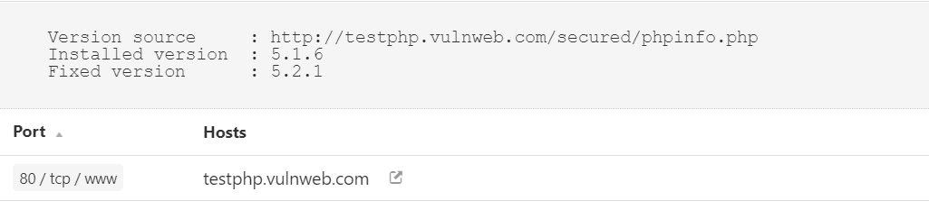
Proof of vulnerability detection

Slide 15
3) PHP < 5.2.11 Multiple Vulnerabilities
Observation
According to its banner, the version of PHP installed on the remote host is older than 5.2.11.
Risk |  | Critical |  | High |  | Medium |  | Low
Such versions may be affected by several security issues : - An unspecified error occurs in certificate validation inside 'php_openssl_apply_verification_policy’. - An unspecified input validation vulnerability affects the color index in 'imagecolortransparent()'. - An unspecified input validation vulnerability affects exif processing. - Calling 'popen()' with an invalid mode can cause a crash under Windows. (Bug #44683) - An integer overflow in 'xml_utf8_decode()' can make it easier to bypass cross-site scripting and SQL injection protection mechanisms using a specially crafted string with a long UTF-8 encoding. (Bug #49687) - 'proc_open()' can bypass 'safe_mode_protected_env_vars'. (Bug #49026)
Recommendations
Upgrade to PHP version 5.2.11 or later.

Slide 16
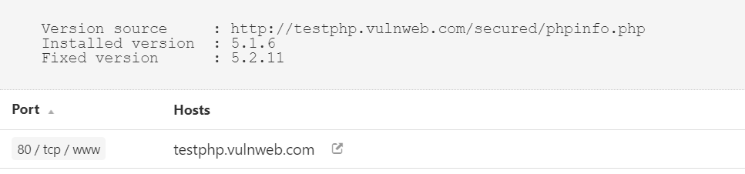
Proof of vulnerability detection

Slide 17
4) PHP < 5.2.3 Multiple Vulnerabilities
Observation
According to its banner, the version of PHP installed on the remote host is older than 5.2.3.
Risk |  | Critical |  | High |  | Medium |  | Low
It is, therefore, affected by multiple vulnerabilities: A buffer overflow in the sqlite_decode_function() in the bundled sqlite library could allow context-dependent attackers to execute arbitrary code. (CVE-2007-1887) A CRLF injection vulnerability in the FILTER_VALIDATE_EMAIL filter could allow an attacker to inject arbitrary email headers via a special email address. This only affects Mandriva Linux 2007.1.(CVE-2007-1900) An infinite-loop flaw was discovered in the PHP gd extension. A script that could be forced to process PNG images from an untrusted source could allow a remote attacker to cause a denial of service. (CVE-2007-2756) An integer overflow flaw was found in the chunk_split() function that ould possibly execute arbitrary code as the apache user if a remote attacker was able to pass arbitrary data to the third argument of chunk_split() (CVE-2007-2872). An open_basedir and safe_mode restriction bypass which could allow context-dependent attackers to determine the existence of arbitrary files. (CVE-2007-3007)
Recommendations
Upgrade to PHP version 5.2.3 or later.

Slide 18
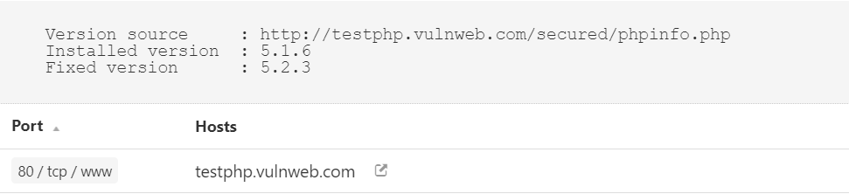
Proof of vulnerability detection

Slide 19
5) PHP < 5.2.6 Multiple Vulnerabilities
Observation
According to its banner, the version of PHP installed on the remote host is older than 5.2.6.
Risk |  | Critical |  | High |  | Medium |  | Low
Such versions may be affected by the following issues : - A stack-based buffer overflow in FastCGI SAPI. - An integer overflow in printf(). - An security issue arising from improper calculation of the length of PATH_TRANSLATED in cgi_main.c. - A safe_mode bypass in cURL. - Incomplete handling of multibyte chars inside escapeshellcmd(). - Issues in the bundled PCRE fixed by version 7.6.
Recommendations
Upgrade to PHP version 5.2.6 or later.

Slide 20
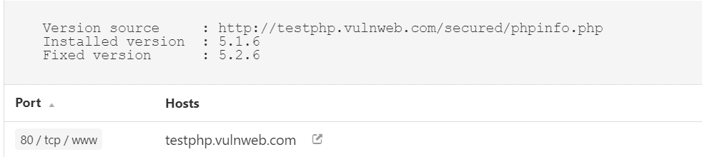
Proof of vulnerability detection

Slide 21
6) PHP < 5.2.8 Multiple Vulnerabilities
Observation
According to its banner, the version of PHP installed on the remote host is earlier than 5.2.8. As such, it is
Risk |  | Critical |  | High |  | Medium |  | Low
This version can be potentially affected by the following vulnerabilities : - PHP fails to properly sanitize error messages of arbitrary HTML or script code, would code allow for cross-site scripting attacks if PHP's 'display_errors' setting is enabled. (CVE-2008-5814) - Version 5.2.7 introduced a regression with regard to 'magic_quotes' functionality due to an incorrect fix to the filter extension. As a result, the 'magic_quotes_gpc' setting remains off even if it is set to on. (CVE-2008-5844)
Recommendations
Upgrade to PHP version 5.2.8 or later.

Slide 22
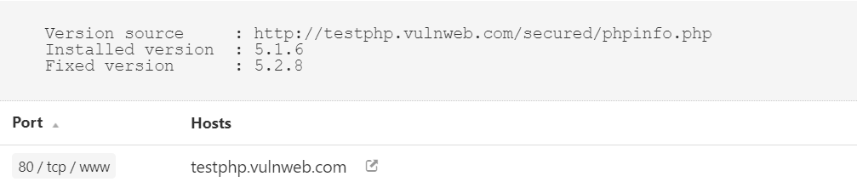
Proof of vulnerability detection

Slide 23
7) PHP < 5.3.12/5.4.2 cgi query string code execution
Observation
According to its banner, the version of PHP installed on the remote host is earlier than 5.3.12 / 5.4.2.
Risk |  | Critical |  | High |  | Medium |  | Low
This version can be potentially affected by a remote code execution and information disclosure vulnerability. An error in the file 'sapi/cgi/cgi_main.c' can allow a remote attacker to obtain PHP source code from the web server or to potentially execute arbitrary code. In vulnerable configurations, PHP treats certain query string parameters as command line arguments including switches such as '-s', '-d', and '-c'. Note that this vulnerability is exploitable only when PHP is used in CGI-based configurations. Apache with 'mod_php' is not an exploitable configuration.
Recommendations
Upgrade to PHP version 5.3.12/5.4.2 or later. A ‘mod_rewrite’ workaround is available as well.

Slide 24
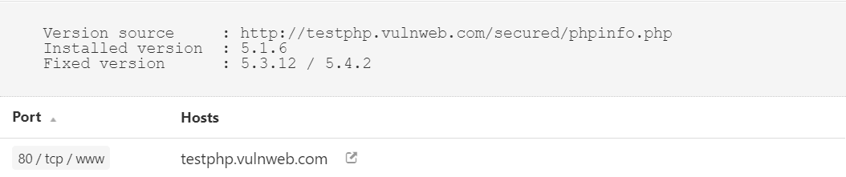
Proof of vulnerability detection

Slide 25
8) PHP < 5.3.9 multiple vulnerabilities
Observation
According to its banner, the version of PHP installed on the remote host is older than 5.3.9.
Risk |  | Critical |  | High |  | Medium |  | Low
As such, it may be affected by the following security issues : - The 'is_a()' function in PHP 5.3.7 and 5.3.8 triggers a call to '__autoload()'. (CVE-2011-3379) - It is possible to create a denial of service condition by sending multiple, specially crafted requests containing parameter values that cause hash collisions when computing the hash values for storage in a hash table. (CVE-2011-4885) - An integer overflow exists in the exif_process_IFD_TAG function in exif.c that can allow a remote attacker to read arbitrary memory locations or cause a denial of service condition. This vulnerability only affects PHP 5.4.0beta2 on 32-bit platforms. (CVE-2011-4566) - Calls to libxslt are not restricted via xsltSetSecurityPrefs(), which could allow an attacker to create or overwrite files, resulting in arbitrary code execution. (CVE-2012-0057) - An error exists in the function 'tidy_diagnose' that can allow an attacker to cause the application to dereference a NULL pointer. This causes the application to crash. (CVE-2012-0781) - The 'PDORow' implementation contains an error that can cause application crashes when interacting with the session feature. (CVE-2012-0788) - An error exists in the timezone handling such that repeated calls to the function 'strtotime' can allow a denial of service attack via memory consumption. (CVE-2012-0789)

Slide 26
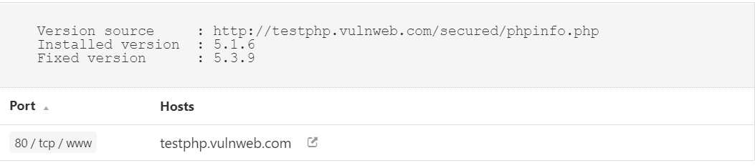
8) PHP < 5.3.9 Multiple Vulnerabilities
Recommendations
Upgrade to PHP version 5.3.9 or later.
Proof of vulnerability detection

Slide 27
9) PHP < 7.3.24 Multiple vulnerabilities
Observation
According to its self-reported version number, the version of PHP running on the remote web server is prior to 7.3.24.
Risk |  | Critical |  | High |  | Medium |  | Low
It is, therefore affected by multiple vulnerabilities
Recommendations
Upgrade to PHP version 7.3.24 or later.

Slide 28
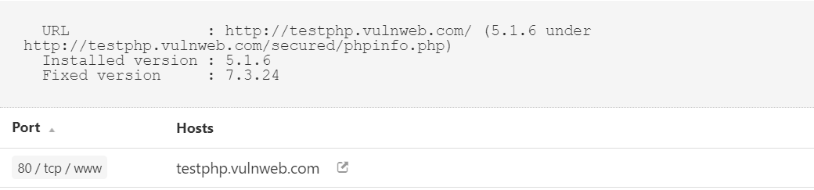
Proof of vulnerability detection

Slide 29
10) PHP 5x< 5.2 Multiple vulnerabilities
Observation
According to its banner, the version of PHP 5.x installed on the remote host is older than 5.2.
Risk |  | Critical |  | High |  | Medium |  | Low
Such versions may be affected by several buffer overflows. To exploit these issues, an attacker would need the ability to upload an arbitrary PHP script on the remote server or to manipulate several variables processed by some PHP functions such as 'htmlentities().'
Recommendations
Upgrade to PHP version 5.2.0 or later.

Slide 30
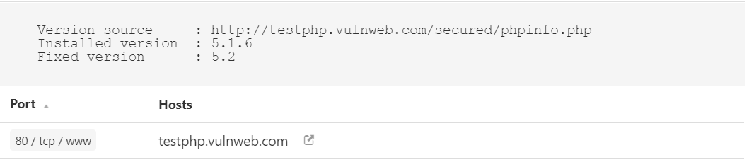
Proof of vulnerability detection

Slide 31
11) PHP 5x< 5.2.2 Multiple vulnerabilities
Observation
According to its banner, the version of PHP 5.x installed on the remote host is older than 5.2.2.
Risk |  | Critical |  | High |  | Medium |  | Low
It is, therefore, affected by multiple vulnerabilities: - A heap-based buffer overflow vulnerability was found in PHP's gd extension. A script that could be forced to process WBMP images from an untrusted source could result in arbitrary code execution. (CVE-2007-1001) - A vulnerability in the way the mbstring extension setglobal variables was discovered where a script using the mb_parse_str() function to set global variables could be forced to to enable the register_globals configuration option, possibly resulting in global variable injection. (CVE-2007-1583) - A context-dependent attacker could read portions of heap memory by executing certain scripts with a serialized data input string beginning with 'S:', which did not properly track the number of input bytes being processed. (CVE-2007-1649) - A vulnerability in how PHP's mail() function processed email messages, truncating potentially important information after the first ASCIIZ (\0) byte. (CVE-2007-1717)
Recommendations
Upgrade to PHP version 5.2.2 or later.

Slide 32
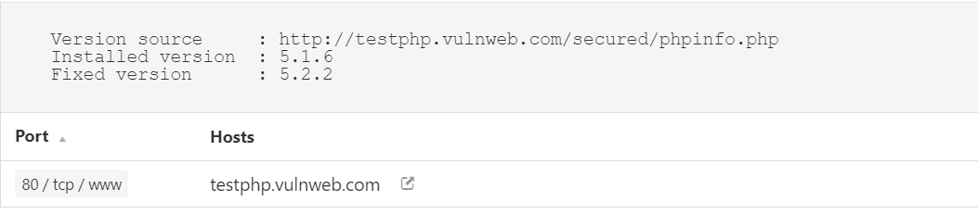
Proof of vulnerability detection

Slide 33
12) PHP < 5.2.10 Multiple vulnerabilities
Observation
According to its banner, the version of PHP installed on the remote host is older than 5.2.10
Risk |  | Critical |  | High |  | Medium |  | Low
. Such versions are reportedly affected by multiple vulnerabilities : - Sufficient checks are not performed on fields reserved for offsets in function 'exif_read_data()'. Successful exploitation of this issue could result in a denial of service condition. (bug 48378) - Provided 'safe_mode_exec_dir' is not set (not set by default), it may be possible to bypass 'safe_mode' restrictions by preceding a backslash in functions such as 'exec()', 'system()', 'shell_exec()', 'passthru()' and 'popen()' on a system running PHP on Windows. (bug 45997)
Recommendations
Upgrade to PHP version 5.2.1 or later.

Slide 34
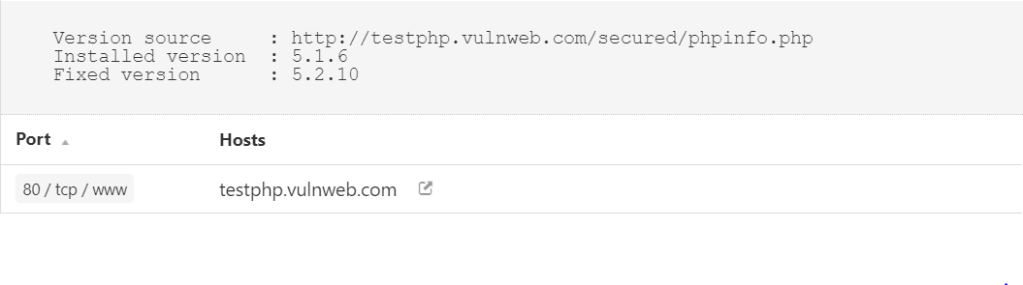
Proof of vulnerability detection

Slide 35
13) PHP < 5.2.12 Multiple vulnerabilities
Observation
According to its banner, the version of PHP installed on the remote host is older than 5.2.12.
Risk |  | Critical |  | High |  | Medium |  | Low
Such versions may be affected by several security issues : - It is possible to bypass the 'safe_mode' configuration setting using 'tempnam()'. (CVE-2009-3557) - It is possible to bypass the 'open_basedir' configuration setting using 'posix_mkfifo()'. (CVE-2009-3558) - Provided file uploading is enabled (it is by default), an attacker can upload files using a POST request with 'multipart/form-data' content even if the target script doesn't actually support file uploads per se. By supplying a large number (15,000+) of files, an attacker could cause the web server to stop responding while it processes the file list. (CVE-2009-4017) - Missing protection for '$_SESSION' from interrupt corruption and improved 'session.save_path' check. (CVE-2009-4143) - Insufficient input string validation in the 'htmlspecialchars()' function. (CVE-2009-4142)
Recommendations
Upgrade to PHP version 5.2.12 or later.

Slide 36
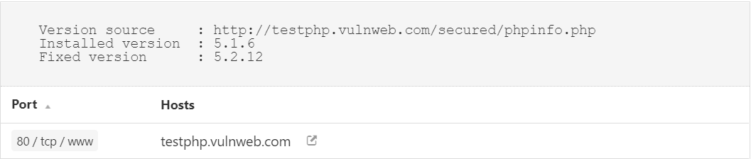
Proof of vulnerability detection

Slide 37
14) PHP < 5.2.4 Multiple vulnerabilities
Observation
According to its banner, the version of PHP installed on the remote host is older than 5.2.4.
Risk |  | Critical |  | High |  | Medium |  | Low
Such versions may be affected by various issues, including but not limited to several overflows.
Recommendations
Upgrade to PHP version 5.2.4 or later.

Slide 38

Proof of vulnerability detection

Slide 39
15) PHP < 5.2.5 Multiple vulnerabilities
Observation
According to its banner, the version of PHP installed on the remote host is older than 5.2.5.
Risk |  | Critical |  | High |  | Medium |  | Low
Such versions may be affected by various issues, including but not limited to several buffer overflows.
Recommendations
Upgrade to PHP version 5.2.5 or later.

Slide 40

Proof of vulnerability detection

Slide 41
16) PHP < 5.2.9 Multiple vulnerabilities
Observation
According to its banner, the version of PHP installed on the remote host is older than 5.2.9.
Risk |  | Critical |  | High |  | Medium |  | Low
Such versions may be affected by several security issues : - Background color is not correctly validated with a non true color image in function 'imagerotate()'. (CVE-2008-5498) - A denial of service condition can be triggered by trying to extract zip files that contain files with relative paths in file or directory names. - Function 'explode()' is affected by an unspecified vulnerability. - It may be possible to trigger a segfault by passing a specially crafted string to function 'json_decode()'. - Function 'xml_error_string()' is affected by a flaw which results in messages being off by one.
Recommendations
Upgrade to PHP version 5.2.9 or later.

Slide 42

Proof of vulnerability detection

Slide 43
17) PHP < 5.3.11 Multiple vulnerabilities
Observation
According to its banner, the version of PHP installed on the remote host is earlier than 5.3.11, and as such is
Risk |  | Critical |  | High |  | Medium |  | Low
Thses can be potentially affected by multiple vulnerabilities : - During the import of environment variables, temporary changes to the 'magic_quotes_gpc' directive are not handled properly. This can lower the difficulty for SQL injection attacks. (CVE-2012-0831) - The '$_FILES' variable can be corrupted because the names of uploaded files are not properly validated. (CVE-2012-1172) - The 'open_basedir' directive is not properly handled by the functions 'readline_write_history' and 'readline_read_history'. - The 'header()' function does not detect multi-line headers with a CR. (Bug #60227 / CVE-2011-1398).
Recommendations
Upgrade to PHP version 5.3.11 or later.

Slide 44

Proof of vulnerability detection

Slide 45
18) PHP < 5.3.2/5.2.13 Multiple vulnerabilities
Observation
According to its banner, the version of PHP installed on the remote host is older than 5.3.2 / 5.2.13.
Risk |  | Critical |  | High |  | Medium |  | Low
Such versions may be affected by several security issues : - Directory paths not ending with '/' may not be correctly validated inside 'tempnam()' in 'safe_mode' configuration. - It may be possible to bypass the 'open_basedir'/ 'safe_mode' configuration restrictions due to an error in session extensions. - An unspecified vulnerability affects the LCG entropy.
Recommendations
Upgrade to PHP version 5.3.2/5.2.13 or later.

Slide 46
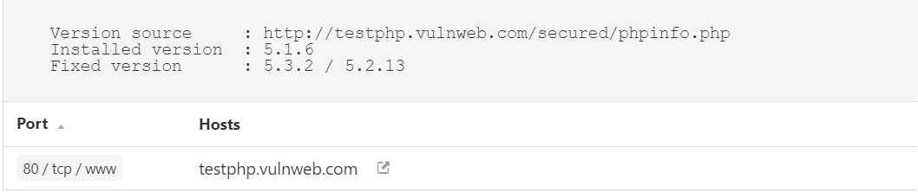
Proof of vulnerability detection

Slide 47
19) PHP PHP_RSHUTDOWN_FUNCTION Security Bypass
Observation
According to its banner, the version of PHP 5.x installed on the remote host is 5.x prior to 5.3.11 or 5.4.x prior to 5.4.1 and thus, is potentially affected by a security bypass vulnerability. .
Risk |  | Critical |  | High |  | Medium |  | Low
An error exists related to the function 'PHP_RSHUTDOWN_FUNCTION' in the libxml extension and the 'stream_close' method that could allow a remote attacker to bypass 'open_basedir' protections and obtain sensitive information.
Recommendations
Upgrade to PHP version 5.3.11 / 5.4.1 or later.

Slide 48
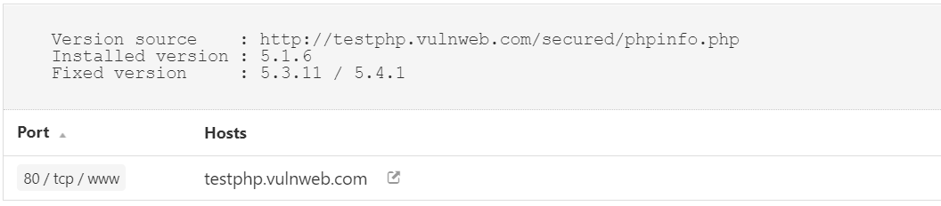
Proof of vulnerability detection

Slide 49
20) WEB SERVER info.php/phpinfo.php detection
Observation
Many PHP installation tutorials instruct the user to create a PHP file that calls the PHP function 'phpinfo()' for debugging purposes. Various PHP applications may also include such a file
Risk |  | Critical |  | High |  | Medium |  | Low
. By accessing such a file, a remote attacker can discover a large amount of information about the remote web server, including : - The username of the user who installed PHP and if they are a SUDO user. - The IP address of the host. - The version of the operating system. - The web server version. - The root directory of the web server. - Configuration information about the remote PHP installation.
Recommendations
Remove the affected file(s).

Slide 50
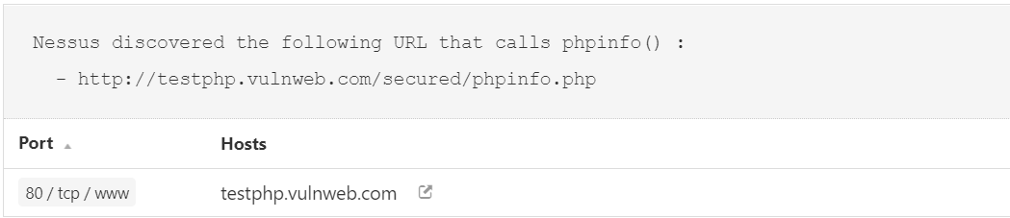
Proof of vulnerability detection

Slide 51
21) CGI GENERIC SQL Injection
Observation
By providing specially crafted parameters to CGIs, Nessus was able to get an error from the underlying database. This error suggests that the CGI is affected by a SQL injection vulnerability.
Risk |  | Critical |  | High |  | Medium |  | Low
An attacker may exploit this flaw to bypass authentication, read confidential data, modify the remote database, or even take control of the remote operating system.
Recommendations
Modify the relevant CGIs so that they properly escape arguments.

Slide 52
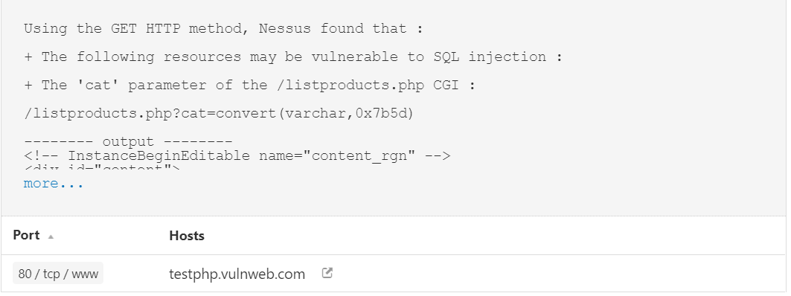
Proof of vulnerability detection

Slide 53
22) CGI GENERIC SQL Injection(2nd pass)
Observation
By providing specially crafted parameters to CGIs, Nessus was able to get an error from the underlying database. This error suggests that the CGI is affected by a SQL injection vulnerability.
Risk |  | Critical |  | High |  | Medium |  | Low
An attacker may exploit this flaw to bypass authentication, read confidential data, modify the remote database, or even take control of the remote operating system.
Recommendations
Modify the relevant CGIs so that they properly escape arguments.

Slide 54
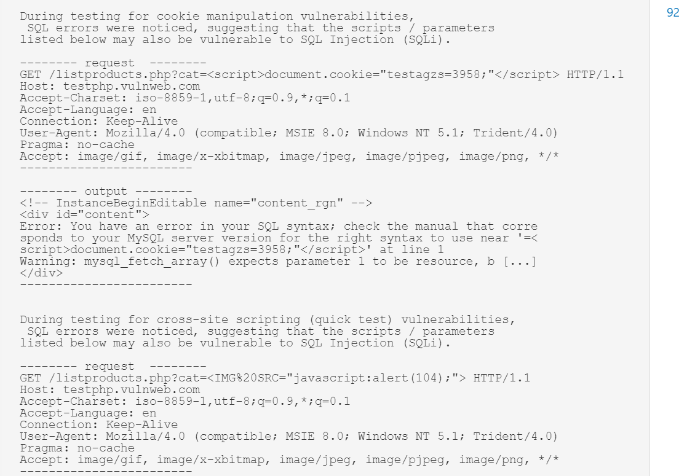
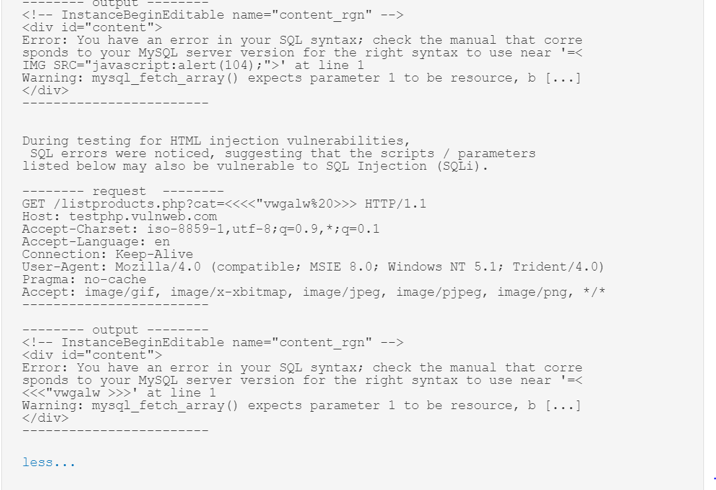
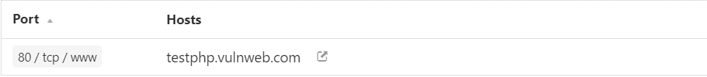
Proof of vulnerability detection

Slide 55
23) browsable web directories
Observation
Multiple Nessus plugins identified directories on the web server that are browsable.
Risk |  | Critical |  | High |  | Medium |  | Low
Browsable directories could allow an attacker to perform a directory traversal attack by viewing "hidden" files in the web root, including CGI scripts, data files, or backup pages.
Recommendations
Make sure that browsable directories do not leak confidential information or give access to sensitive resources. Additionally, use access restrictions or disable directory indexing for any that do.

Slide 56
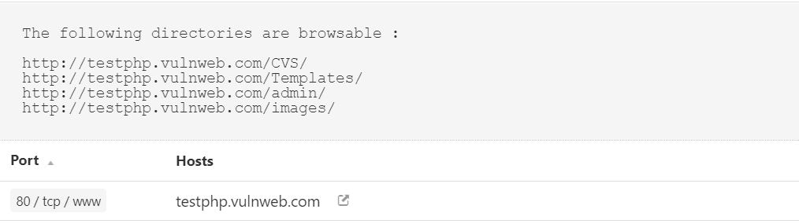
Proof of vulnerability detection

Slide 57
24) Cgi generic cookie injection scripting
Observation
The remote web server hosts at least one CGI script that fails to adequately sanitize request strings with malicious JavaScript
Risk |  | Critical |  | High |  | Medium |  | Low
By leveraging this issue, an attacker may be able to inject arbitrary cookies. Depending on the structure of the web application, it may be possible to launch a 'session fixation' attack using this mechanism.
Recommendations
Restrict access to the vulnerable application. Contact the vendor for a patch or upgrade.

Slide 58
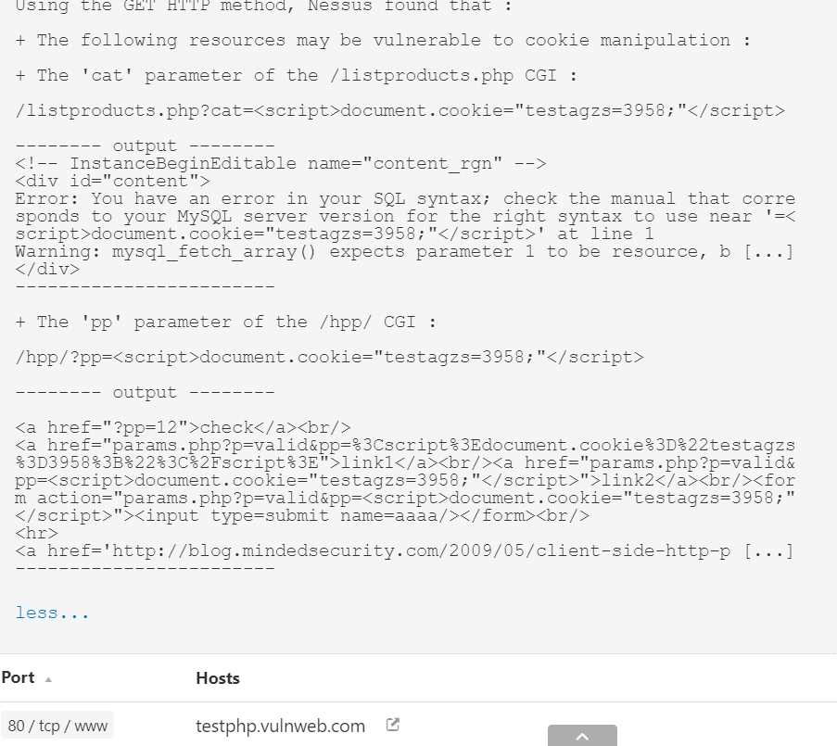
Proof of vulnerability detection

Slide 59
25) Cgi generic Html injections (Quick test)
Observation
The remote web server hosts CGI scripts that fail to adequately sanitize request strings with malicious JavaScript. By leveraging this issue, an attacker may be able to cause arbitrary HTML to be executed in a user's browser within the security context of the affected site.
Risk |  | Critical |  | High |  | Medium |  | Low
The remote web server may be vulnerable to IFRAME injections or cross-site scripting attacks : - IFRAME injections allow 'virtual defacement' that might scare or anger gullible users. Such injections are sometimes implemented for 'phishing' attacks. - XSS are extensively tested by four other scripts. - Some applications (e.g. web forums) authorize a subset of HTML without any ill effect. In this case, ignore this warning
Recommendations
Either restrict access to the vulnerable application or contact the vendor for an update.

Slide 60
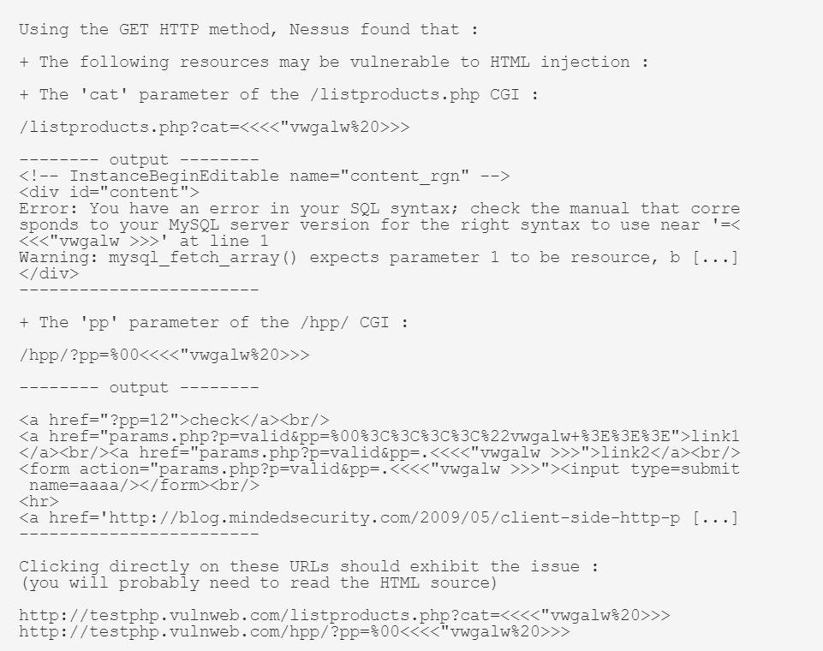
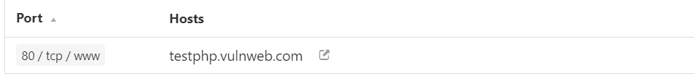
Proof of vulnerability detection

Slide 61
26) Cgi generic xss (Quick test)
Observation
The remote web server hosts CGI scripts that fail to adequately sanitize request strings with malicious JavaScript
Risk |  | Critical |  | High |  | Medium |  | Low
By leveraging this issue, an attacker may be able to cause arbitrary HTML and script code to be executed in a user's browser within the security context of the affected site. . These XSS are likely to be 'non persistent' or 'reflected'.
Recommendations
Restrict access to the vulnerable application. Contact the vendor for a patch or upgrade to address any cross-site scripting vulnerabilities.

Slide 62
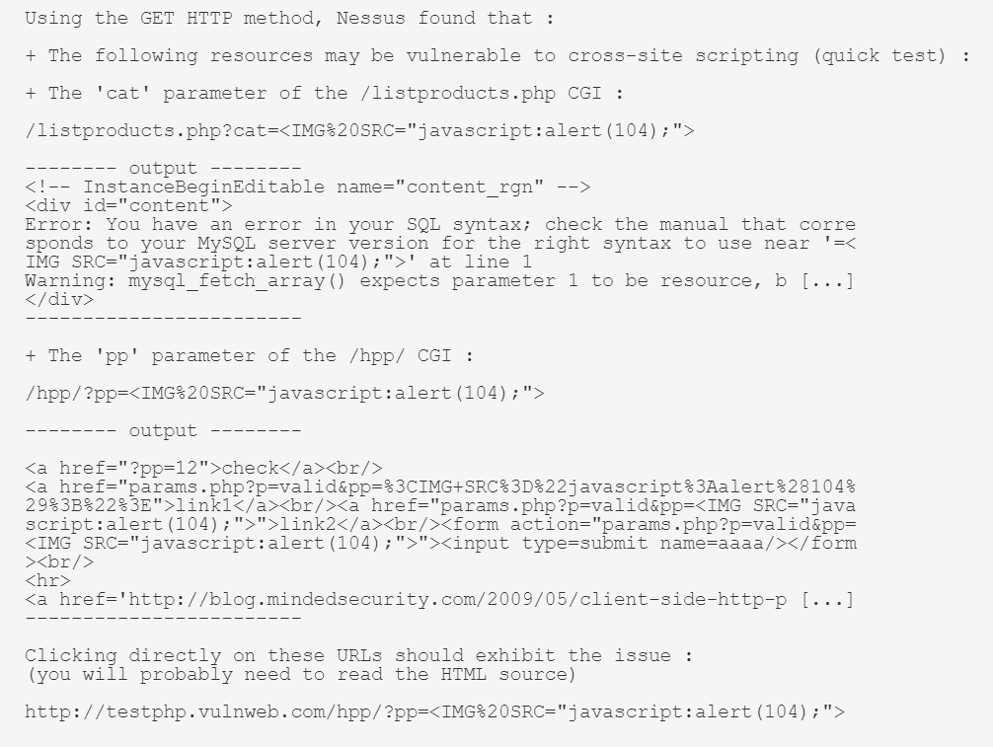
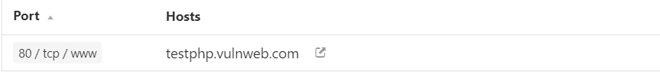
Proof of vulnerability detection

Slide 63
27) WEB application potentially vulnerable to clickjacking
Observation
The remote web server does not set an X-Frame-Options response header or a Content-Security-Policy 'frame-ancestors' response header in all content responses..
Risk |  | Critical |  | High |  | Medium |  | Low
This could potentially expose the site to a clickjacking or UI redress attack, in which an attacker can trick a user into clicking an area of the vulnerable page that is different than what the user perceives the page to be. This can result in a user performing fraudulent or malicious transactions.
Recommendations
Return the X-Frame-Options or Content-Security-Policy (with the 'frame-ancestors' directive) HTTP header with the page's response.This prevents the page's content from being rendered by another site when using the frame or iframe HTML tags..

Slide 64
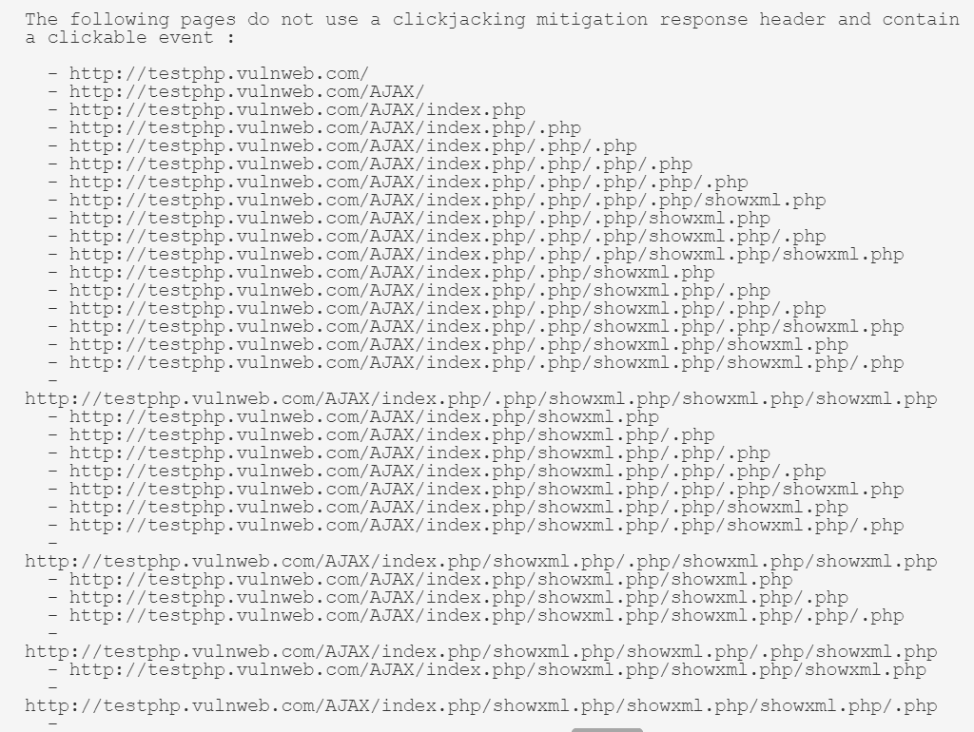
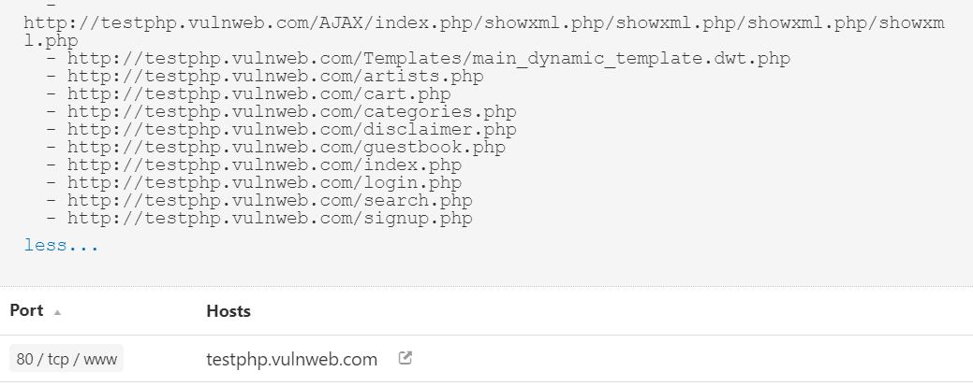
Proof of vulnerability detection

Slide 65
28) WEB application SQL Backend identification
Observation
At least one web application hosted on the remote web server is built on a SQL backend that Nessus was able to identify by looking at error messages.
Risk |  | Critical |  | High |  | Medium |  | Low
Leaking this kind of information may help an attacker fine-tune attacks against the application and its backend.
Recommendations
Filter out error messages.

Slide 66
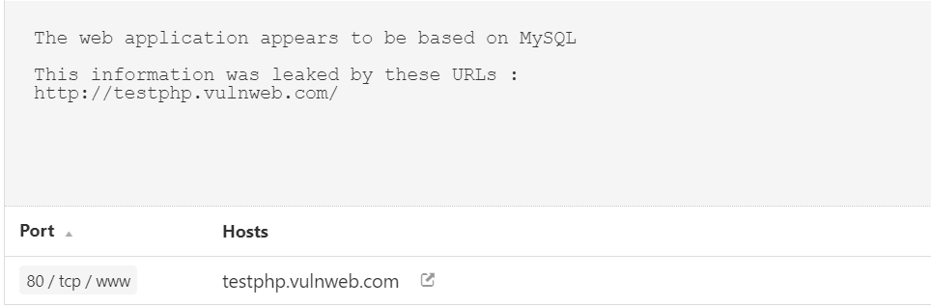
Proof of vulnerability detection

Slide 67
29) web server transmits cleartext credentials
Observation
The remote web server contains several HTML form fields containing an input of type 'password' which transmit their information to a remote web server in cleartext.
Risk |  | Critical |  | High |  | Medium |  | Low
An attacker eavesdropping the traffic between web browser and server may obtain logins and passwords of valid users.
Recommendations
Make sure that every sensitive form transmits content over HTTPS.

Slide 68
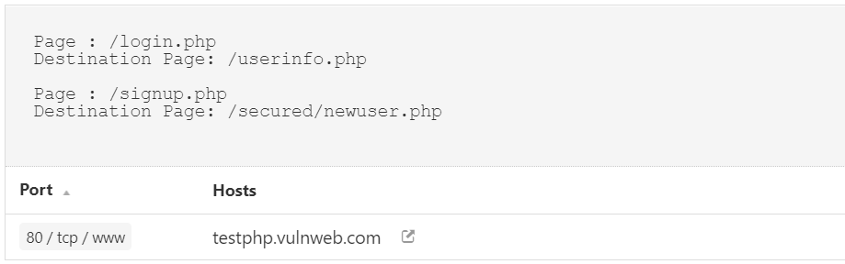
Proof of vulnerability detection

Slide 69

Thank you

Slide 70


Infrastructure security testing report
VA on my host system

Slide 71

Report Details
Operating System | Windows 10
Automatic Scan Performed on | Nessus Essentials

Slide 72

Brief Summary of the assessment
An Overview of Infrastructure Security Testing

Slide 73
Security testing - overview
Background
I performed a white box external vulnerability scan on my system using an automatic scanner.
The main aim of this vulnerability assessment is to identify the security issues within the system.
Result
After the assessment, I found out that there were no vulnerabilities present in the host system
Performed Vulnerability scans to assess the website
Presented the results through this report

Slide 74
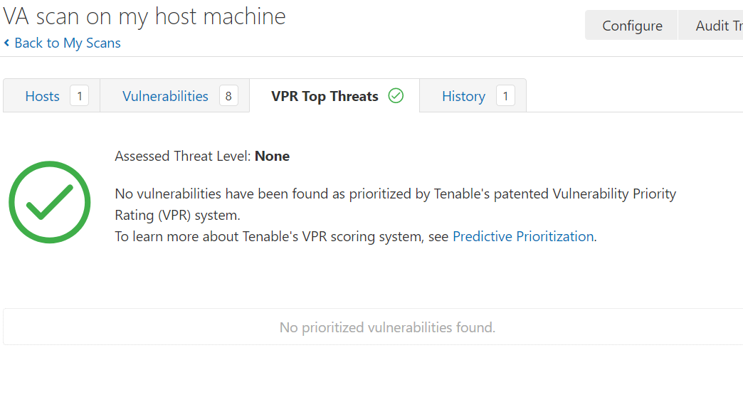
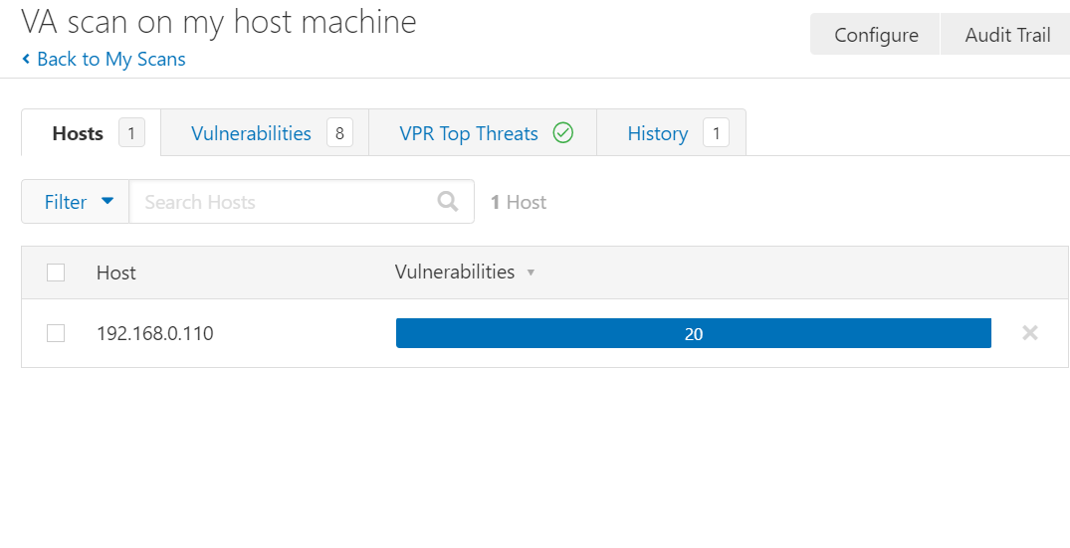
Proof that there were no vulnerabilities in the host system

Slide 75


Slide 76

Finding the password of the zip file and then to crack the hashes hidden in it
Using Kali Linux

Slide 77
Process
For finding the password of the zip file:
I used the tool – “fcrackzip” and launched a dictionary file attack using “rockyou.txt” on the zip file “m1ss10n.zip”.
The command which I used for finding the password is:
“fcrackzip –D –p rockyou.txt –u m1ss10n.zip”
After this command I found out that the password of the zip file is: “ !!!123blahblah!! ”

Slide 78

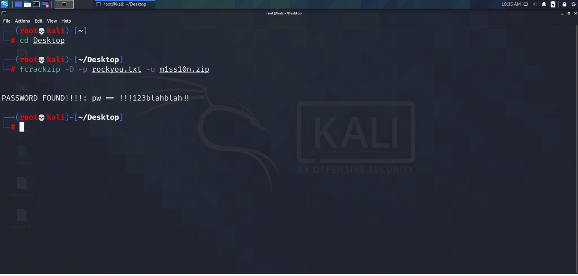
Proof(screenshot of the password)

Slide 79
Process
For cracking the hashes inside the zip file:
After finding the password, I found another test file- “pass.txt” inside the zip file which had 3 hashes in it.
For breaking those 3 three hashes I used the tool- “john the ripper” after unzipping the “m1ss10n.zip” file.
The command I use for cracking 3 hashes is:
“john pass.txt”
Then for displaying the hash passwords I used the command:
“john –show pass.txt”
The hash passwords were:
root-> “kali”
kali-> “kali”
varun-> “!@#$%^&”

Slide 80

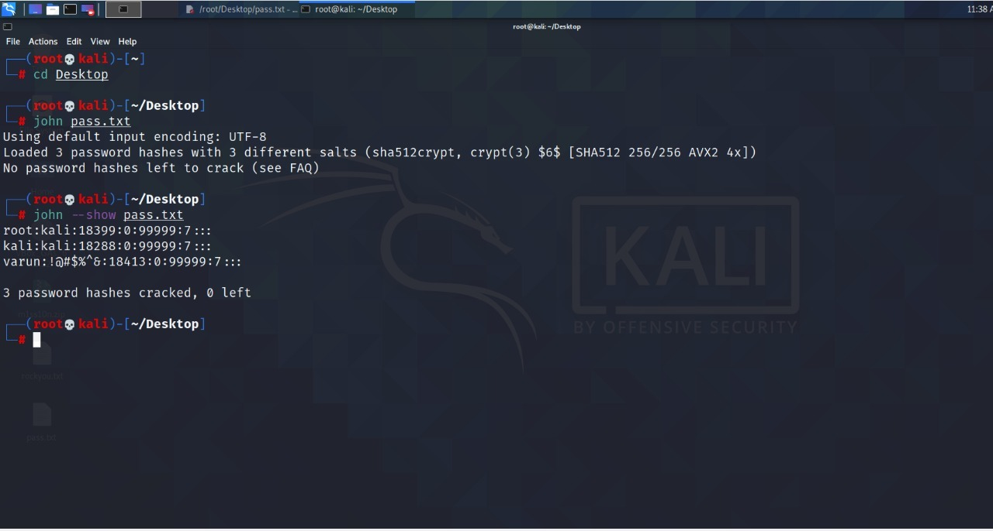
Proof(screenshot of cracked hashes)

Slide 81

Way to hide a video behind an image and running it
Using STEGANOGRAPHY

Slide 82
Process
For hiding a video behind an image the process is :
I opened the command prompt.
In command prompt, I opened the desktop using the command “cd Desktop” as both the files are in Desktop.
Then I compressed the video file using 7zip and converted into a zip file to reduce it’s size.
Now for hiding the video behind an image the command is:
“copy /b image.jpg+secret.zip new,jpg”
Here, image.jpg-> name of the image behind which we want to hide the video
secret.zip-> name of the compressed video file
new.jpg-> the new name of the image after hiding video behind it.
After that command the video will be hidden behind the image. If I want to open the video I can open the image using 7zip file manager and see it.

Slide 83

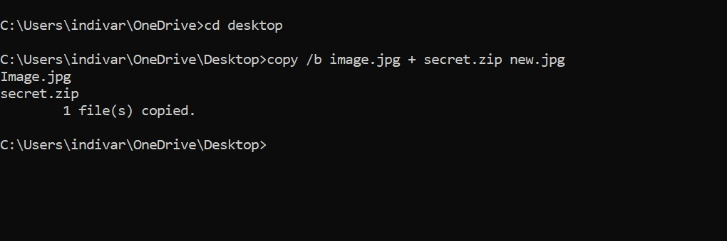
Proof(screenshot of the command)

Slide 84

THE END
THANK YOU

